Slide 1
Welcome
To
our Presentation

Slide 2
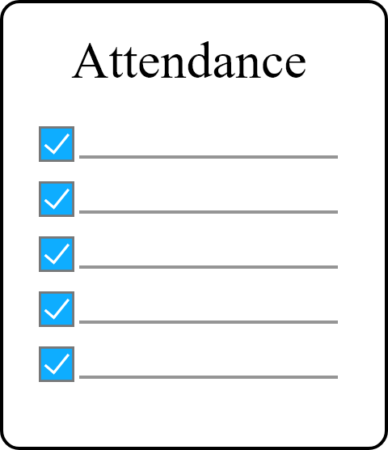
Topic
Student Attendance Management System
……………………………………………………..

Slide 3
Team Member
Monisha Biswas
181-15-1928
Noor Afia Shammi
181-15-1994
Sabbir Ahamed
181-15-1928
Md.Yeasin Sheikh
181-15-2049

Slide 4
About
Noor Afia Shammi 181-15-1928

Slide 5
About
Online attendance.
Batch list.
Students profile.
Send info to parents.
User profile identification.
More……….

Slide 6
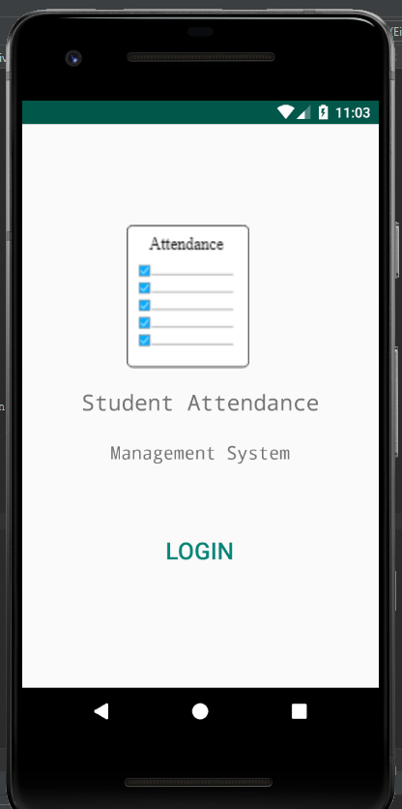
Startup Screen
Auto check login.

Slide 7
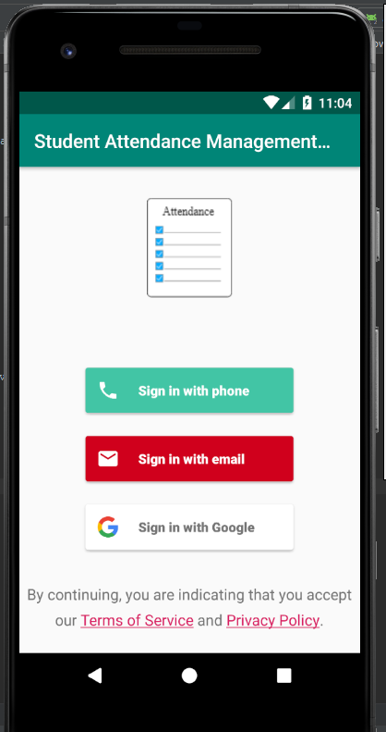
Login Methods
Phone
Email
Google

Slide 8
Authentication
Monisha Biswas
181-15-1928

Slide 9
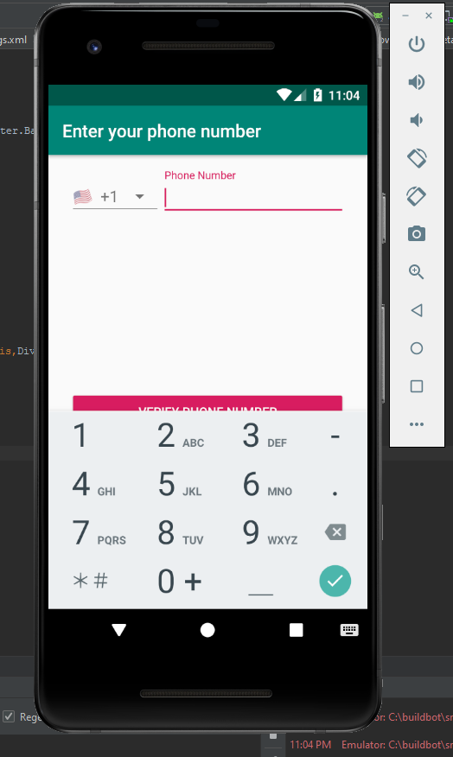
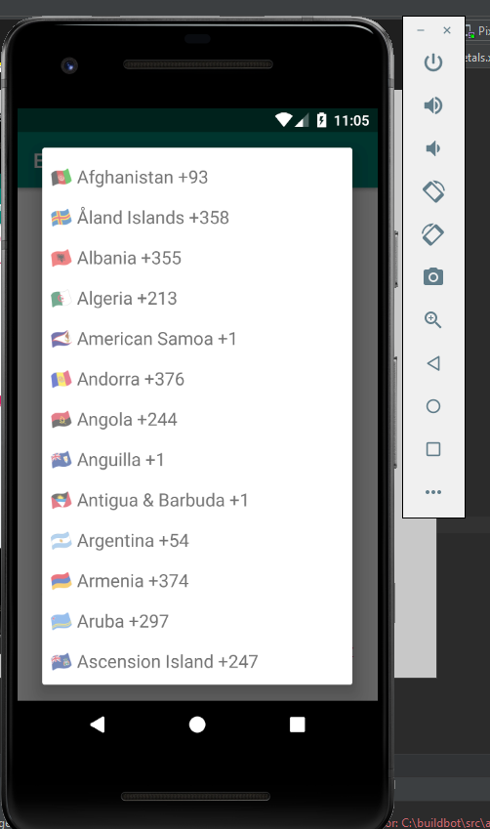
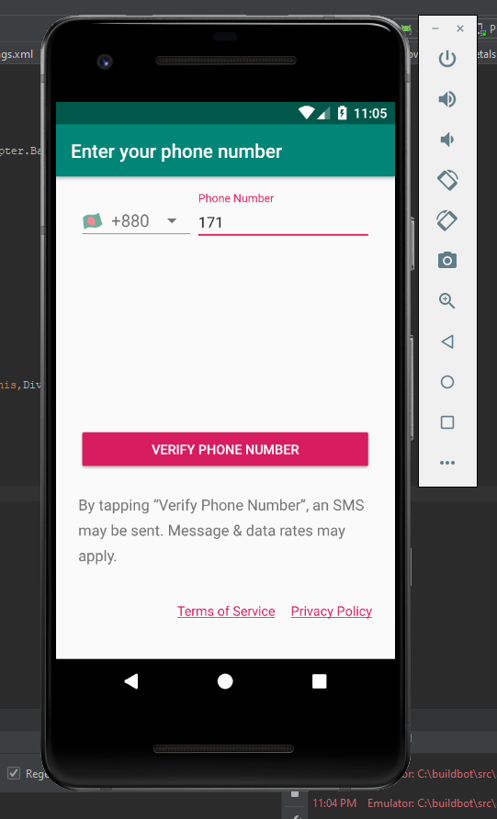
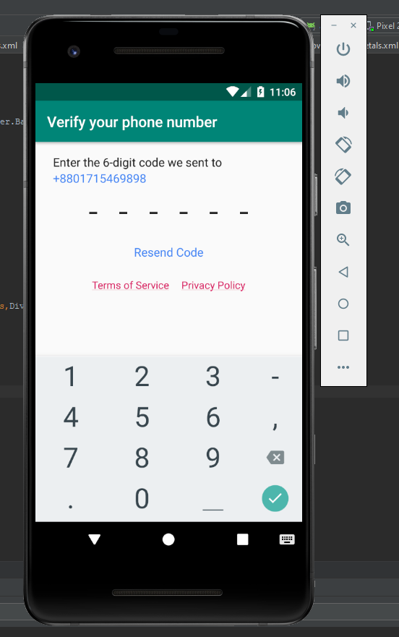
Phone Number Auth.

Slide 10
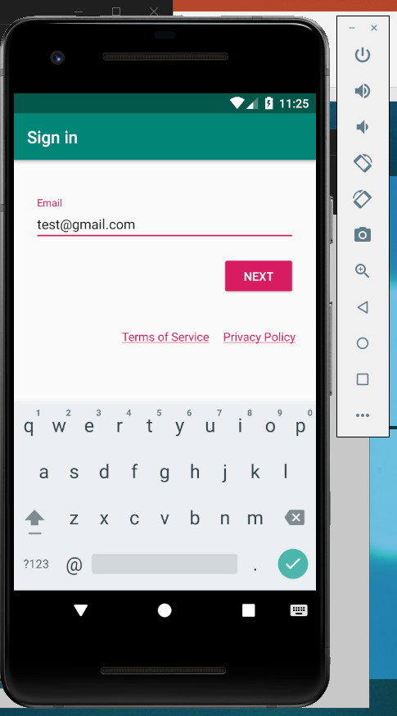
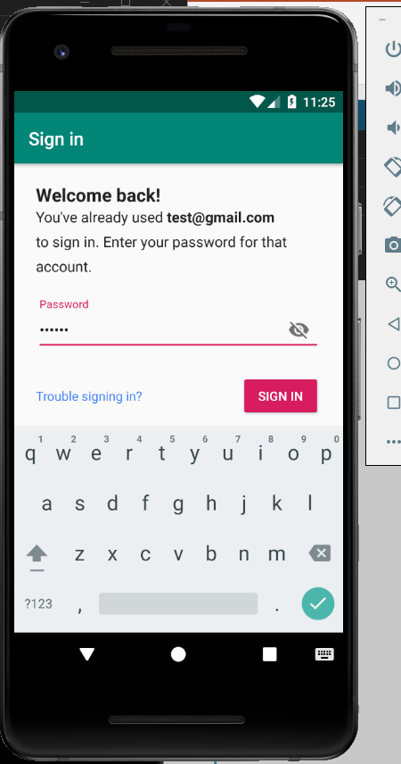
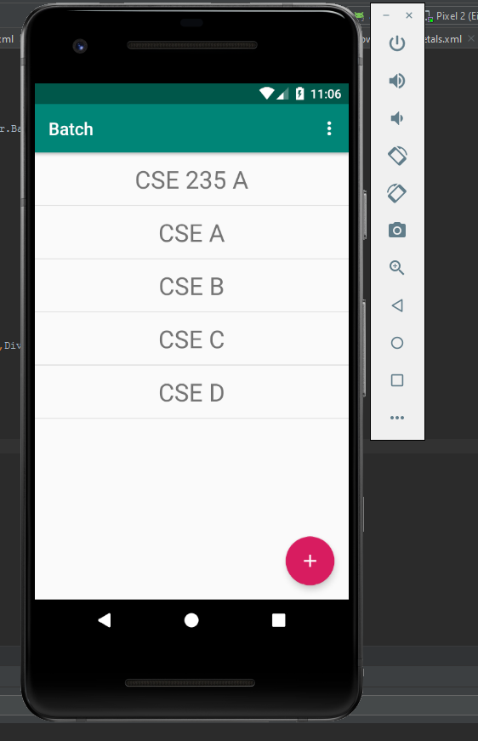
Email Auth.

Slide 11
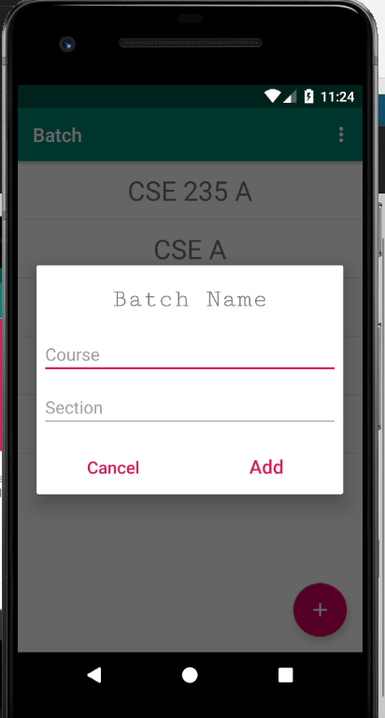
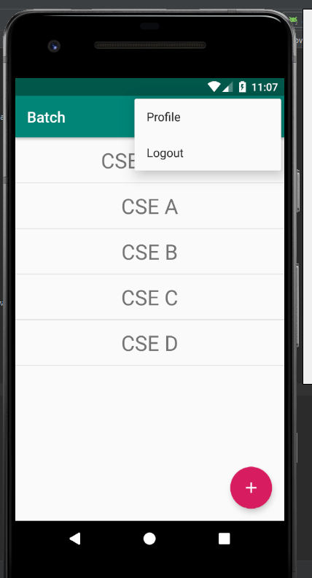
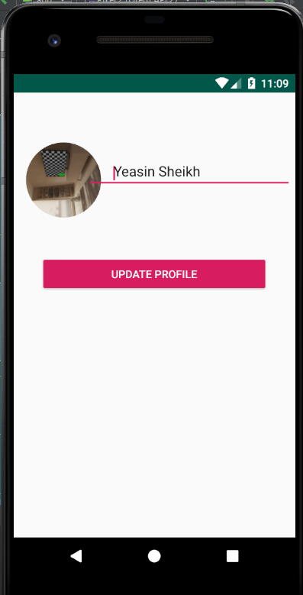
Home

Slide 12
Features
Sabbir Ahmed
181-15-1996

Slide 13
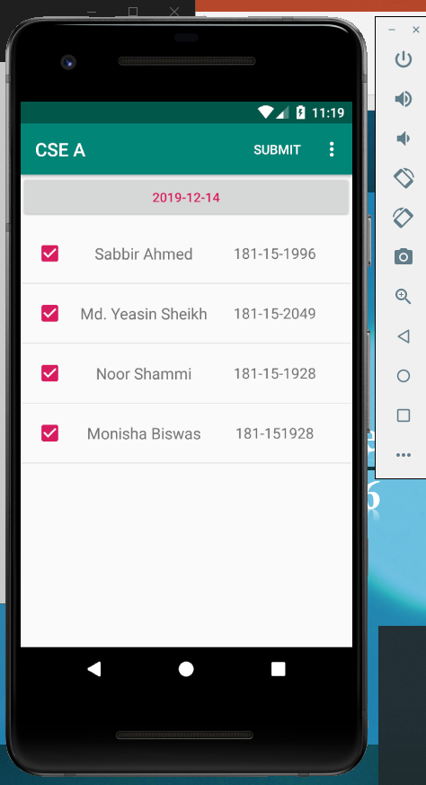
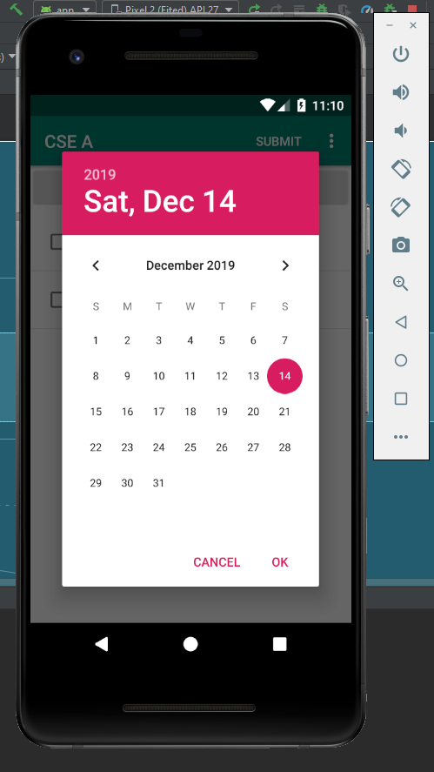
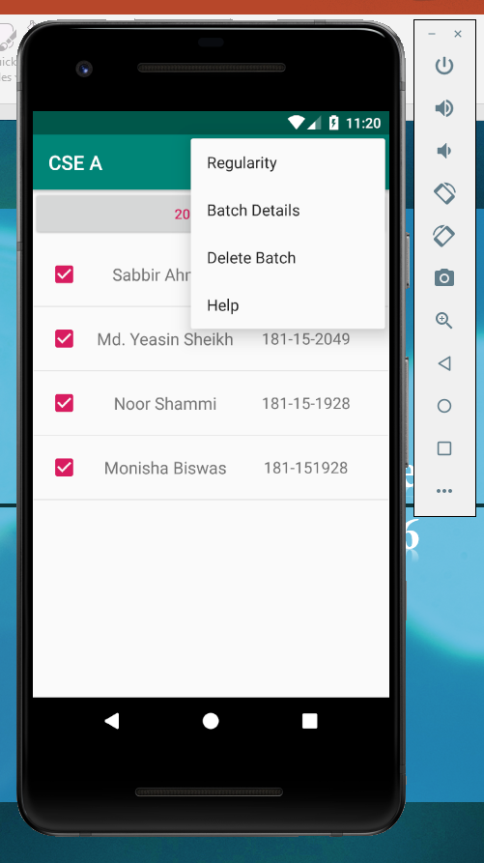
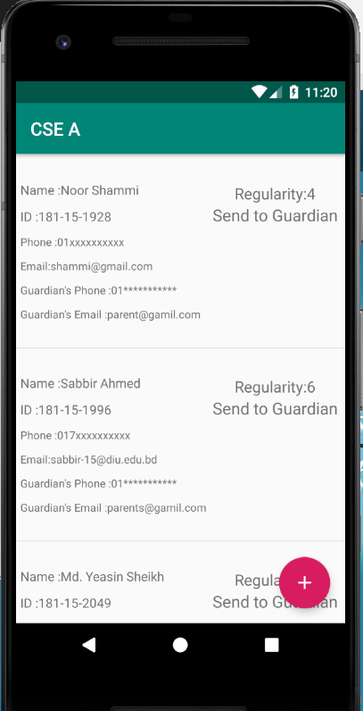
Taking Attendance

Slide 14
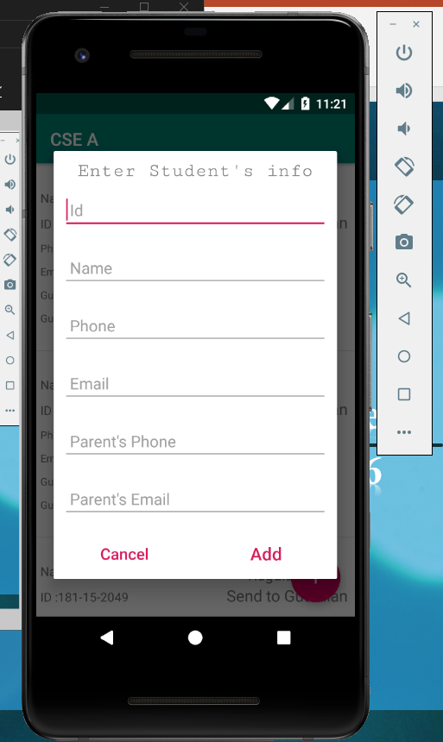
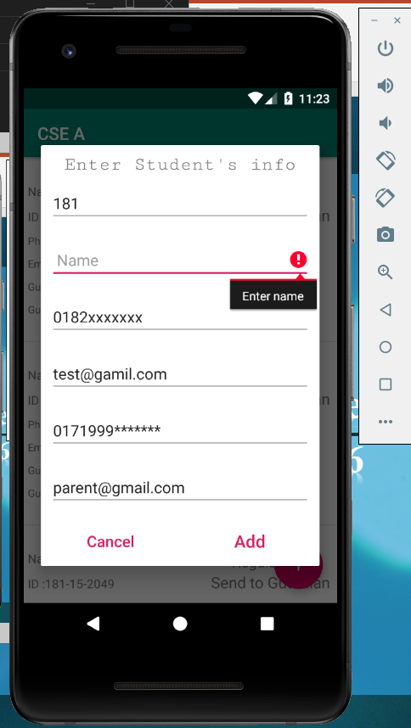
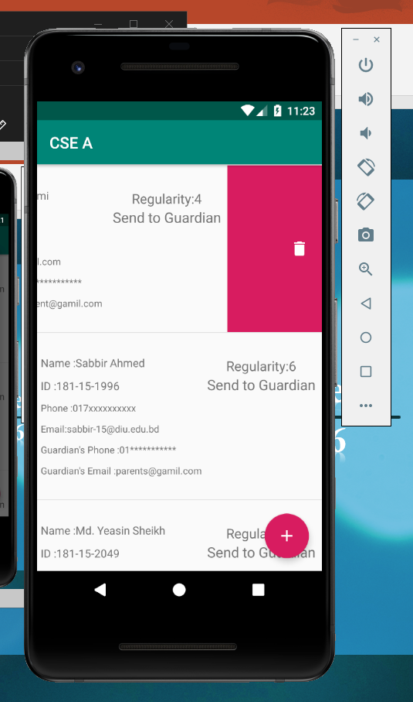
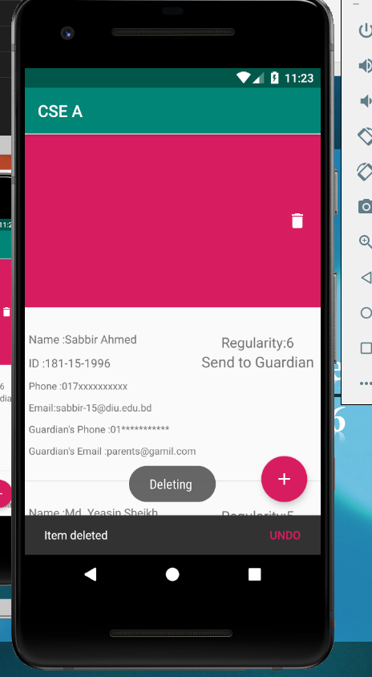
Adding & Deleting student

Slide 15
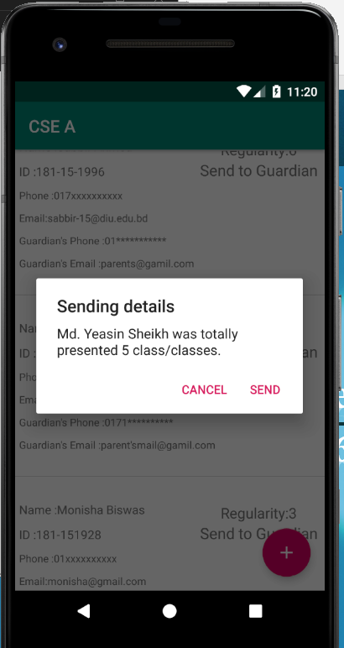


Extra Features

Slide 16
DB Security
Md.Yeasin Sheikh
181-15-2049

Slide 17
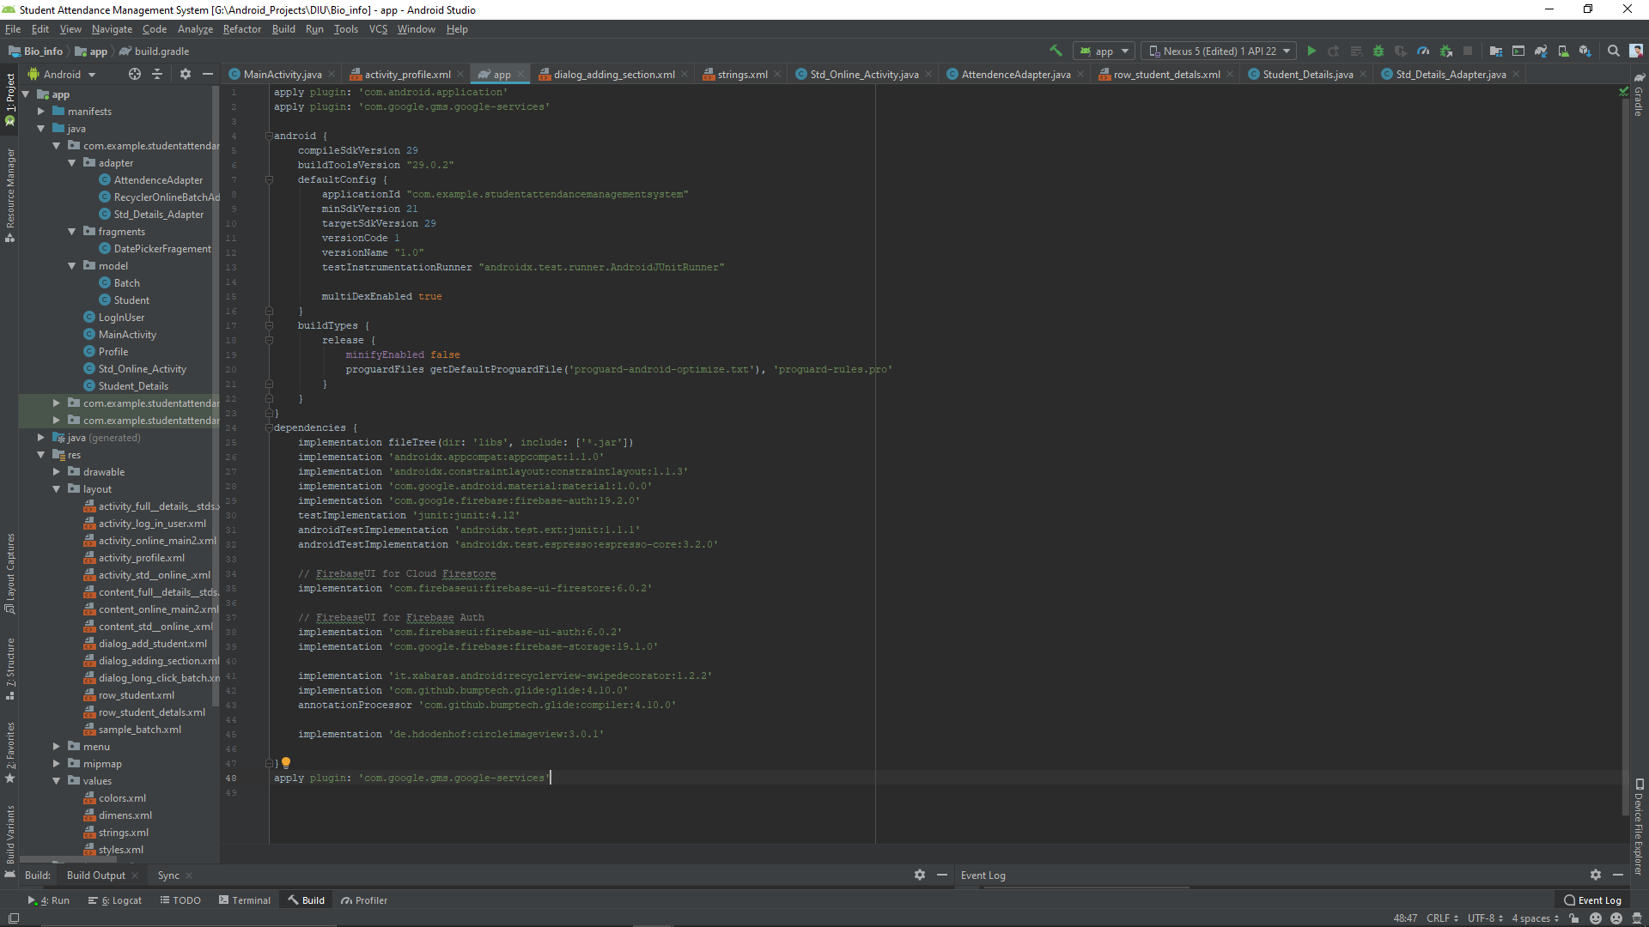
Dependencies

Slide 18
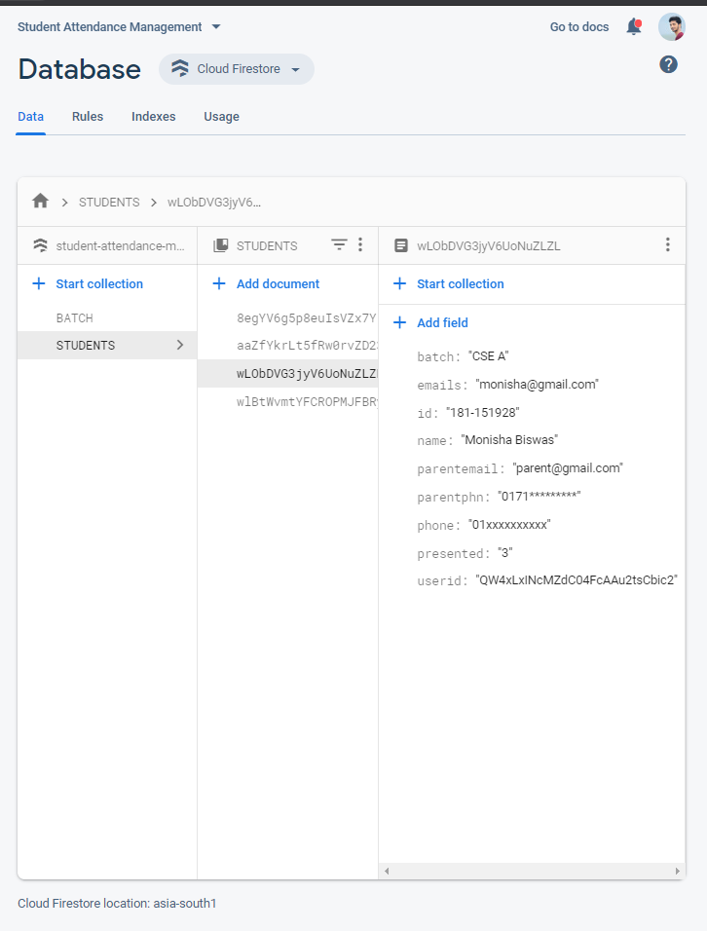
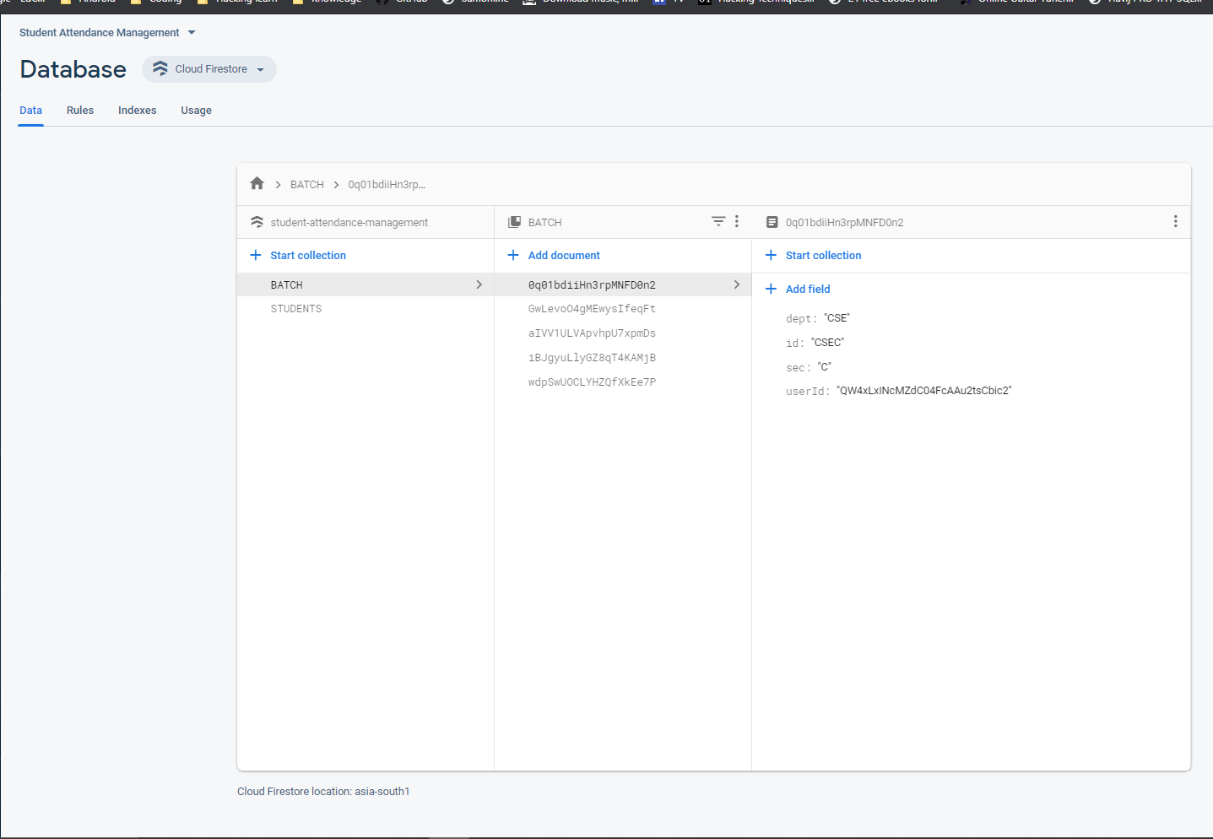

Slide 19
Security –Data Rules
rules_version = '2';
service cloud.firestore {
match /databases/{database}/documents {
match /notes/{noteId}{
allow read : if isAuthenticated() && request.auth.uid == resource.data.userId;
allow create: if isAuthenticated() && request.auth.uid == request.resource.data.userId;
allow update, delete: if isAuthenticated() && request.auth.uid == resource.data.userId;
}
function isAuthenticated(){
return request.auth != null;
}
}
}

Slide 20
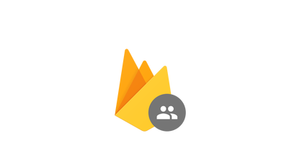
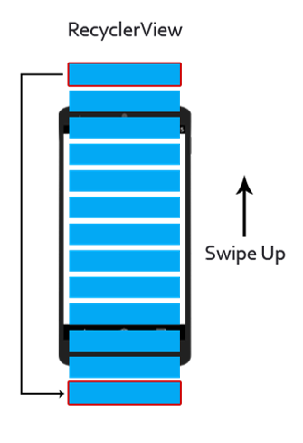

What Makes Us Different ?
Firebase Authentication
Cloud Firestore

Slide 21
Future plan
Offline handleable.
Student Accessibility.
Including Marks System.
Shareable Data.
Department Head Accessibility.
Exclusive UI & more……

Slide 22


